Slide 1

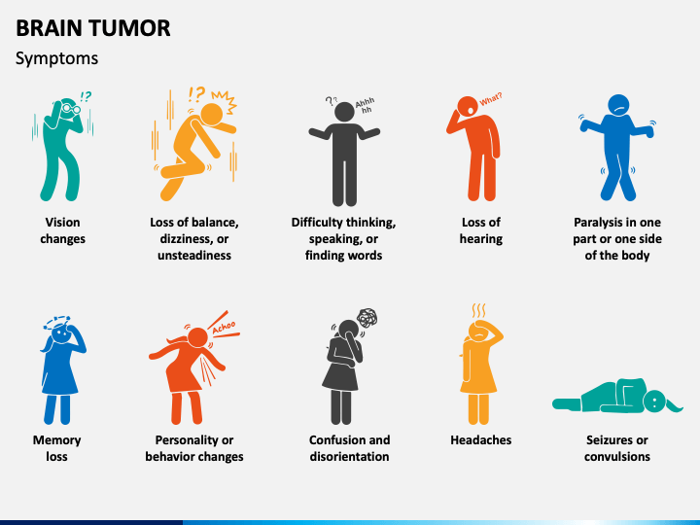
WeCare - The right care right here
Brain Tumor classification & customized patient care system.
Symptom Check Analyzer will guide the patient and will help to arrange a consultation session with a professional.
Users consist of patients diagnosed with Tumor to track growth or shrinkage.
It is based on Patient Experience using AI and Machine Learning addressing the health disparities keeping privacy and security as a prominent priority.
The survey data of general public along with their MRI scans is used. The model uses MRI Scans from sites(approx. 7000 images) for training purpose.
Click here for symptom check

Slide 2
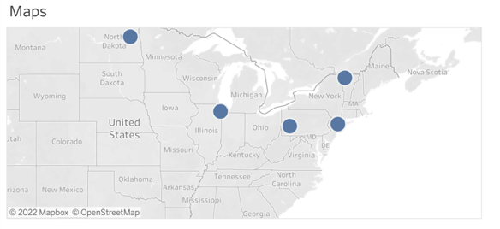
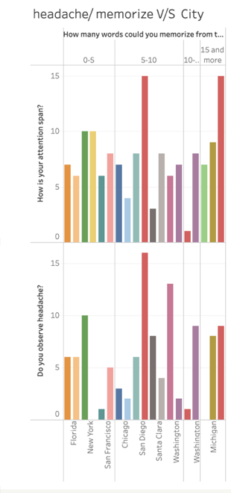
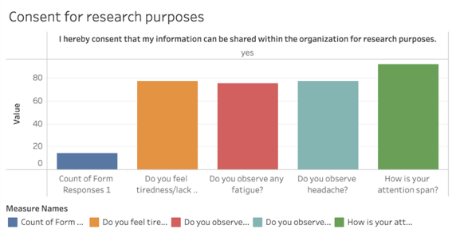
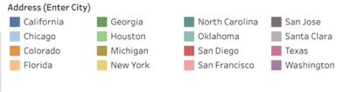
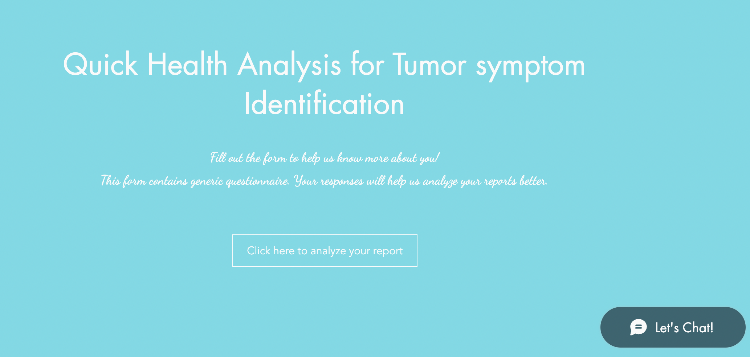
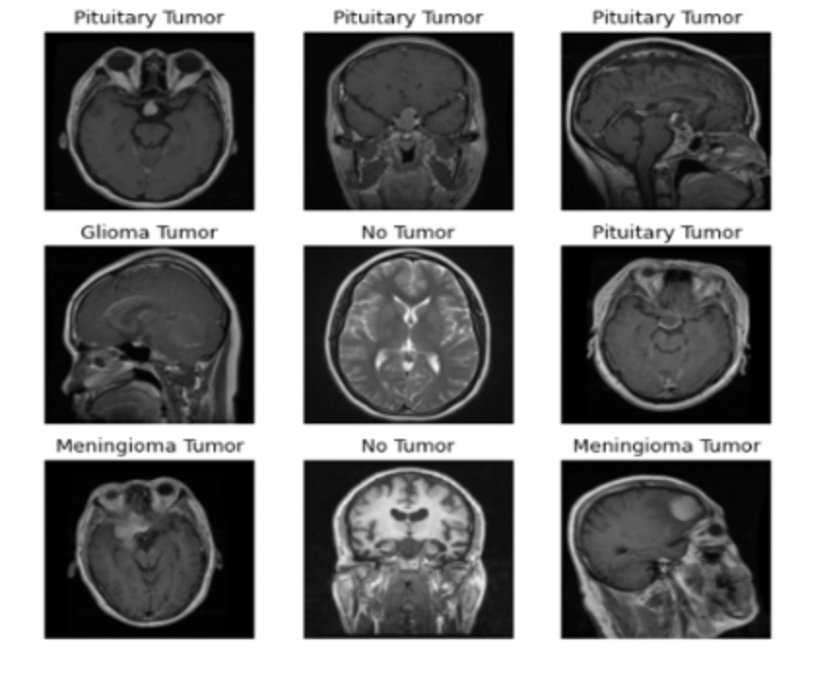
In future we can collaborate and analyze various other cancer types. This can help people to self analyze and get their analysis by just filling out a survey.
Helps in booking appointment and find nearest hospitals and also can get online consultation with a few clicks.

